Slide 1



Employee Training

Slide 2


= A Total Solution
+
JobX helps schools automate the job posting, application submission/review, hire creation/approval, and reporting processes for employees, employers, and site administrators.
TimesheetX helps schools automate the time sheet submission and approval process while ensuring compliance with labor and FWS regulations for employees, Supervisors, and administrators.
JobX and TimesheetX are seamlessly integrated with your Columbia University SOA School information System (SIS).

Slide 3
Benefits for Employees
Apply for multiple jobs with one online application
JobMail enables employees to be notified immediately about jobs that match their job preferences
Job search skills development
Accelerated online hiring process
Eliminated paper forms
Automated notices throughout the JobX lifecycle
Web accessibility
24-hour service

Slide 4

Benefits for Employees
Automated reminder notices to ensure timely submission of your time sheet.
Helpful edits ensure quality time sheet entries.
Award Balance Display
Never a lost time sheet
Web accessibility
Paper Time Sheets Eliminated
Full Work History at your Fingertips

Slide 5

Columbia University SOA Specific Customization
Your site has YOUR Columbia University SOA look and feel
Your site has YOUR Columbia University SOA departments
Your site has YOUR Columbia University SOA custom fields
Your site has been configured to support YOUR custom Columbia University SOA processes.

Slide 6
Training Agenda
How to Login to JobX & TimesheetX
How to Find a Job
How to Apply for a Job
How to Manage your JobMail subscription
‘My Dashboard’ Feature
How to Enter Time
How to Turn in a Time Sheet to Supervisor

Slide 7
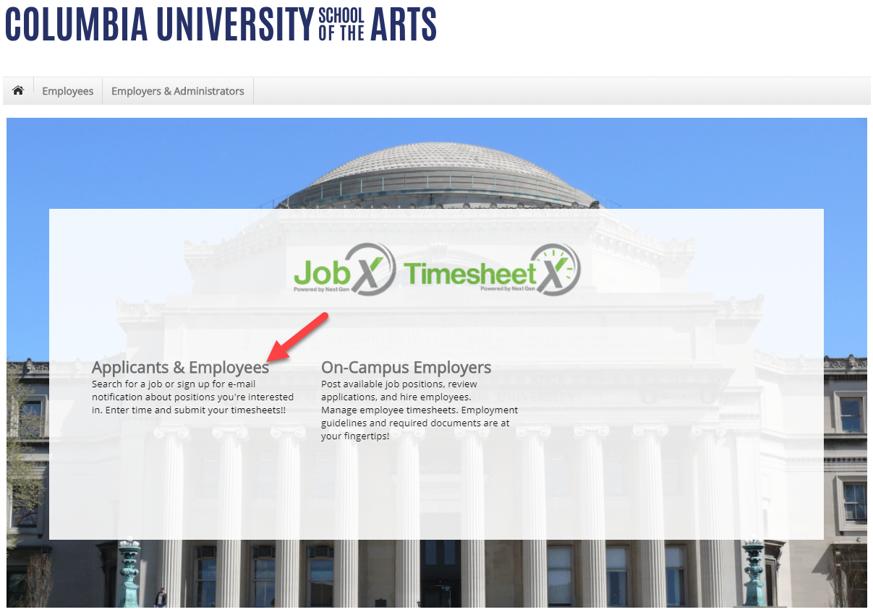
How to Access JobX
Please navigate to the following URL and click the ‘Applicants & Employees’ link.
https://soa.studentemployment.ngwebsolutions.com/

Slide 8
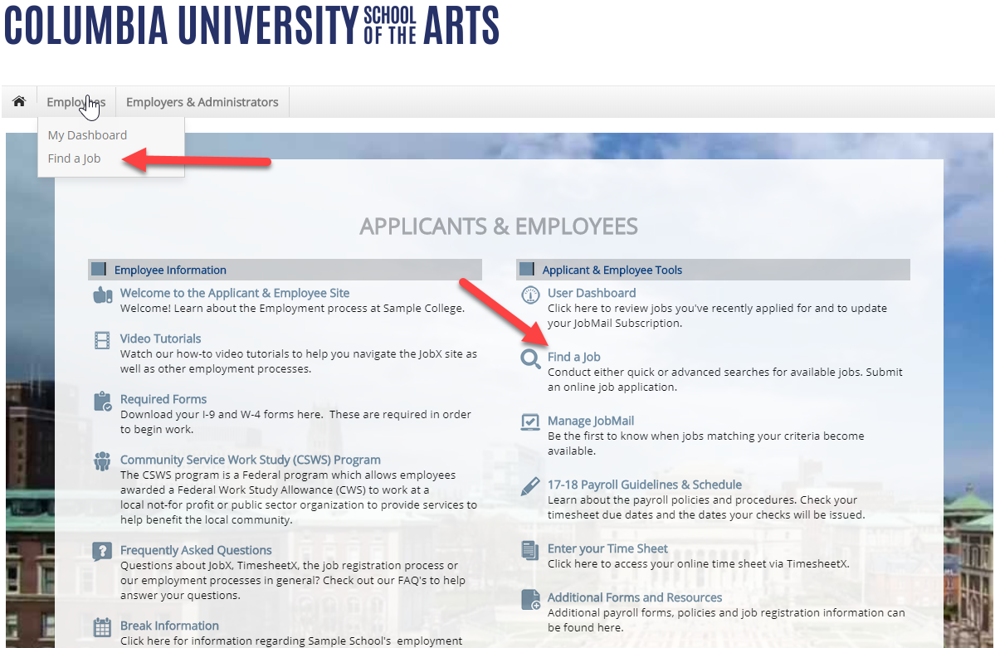
How to Access JobX
Click ‘Find a Job’ on the JobX Applicant & Employees Home Page. Or click ‘Find a Job’ from the Employees menu at the top of the screen.

Slide 9

How to search for a job

Slide 10
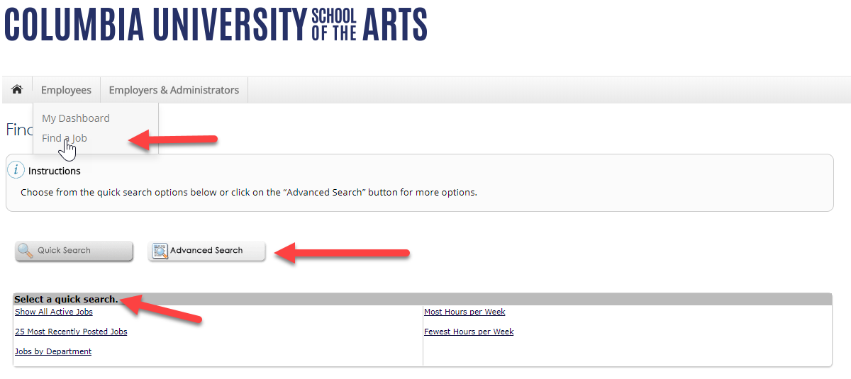
Quick Search: A search containing pre-defined criteria
After clicking the ‘Find a Job’ function, select a specific pre-defined ‘Quick Search’ you would like to utilize to find a job.
Otherwise, to define your own custom job search filters click ‘Advanced Search’.

Slide 11
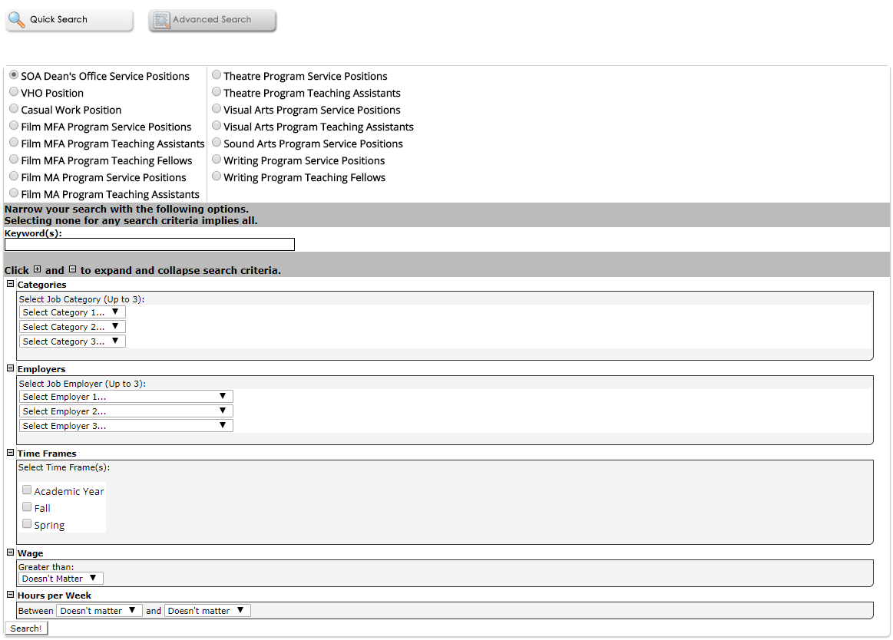
Advanced Search: Define your own custom job criteria
Click the ‘Advanced Search’ button to define your own job criteria you wish to search.
Advanced Search enables you to search for jobs by the following:
  Keyword(s) Search
  Search by Job Type Population (SOA Dean’s Office Service Positions, VHO Position, Casual Work Position, Film MFA Program Service Positions, etc.)
  Job Category, Employers/Department, Time Frame, Wage, and Hours per Week

Slide 12

How to apply for a job

Slide 13
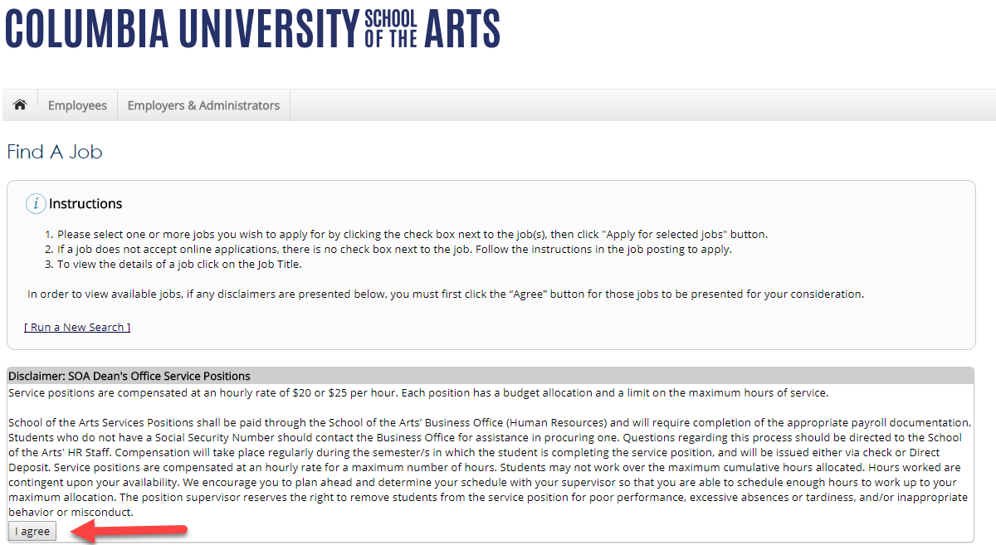
Disclaimer Statements
In order to view available job listings, you may be required to review and agree to one or more Columbia University SOA Disclaimer statements.
A Columbia University SOA Disclaimer statement will be presented for each Job Type (SOA Dean’s Office Service Positions) available.
After you’ve successfully reviewed the applicable Columbia University SOA Disclaimer Statement(s), you will be required to click the ‘I agree’ button(s) before any available jobs of that Job Type population will be presented.

Slide 14
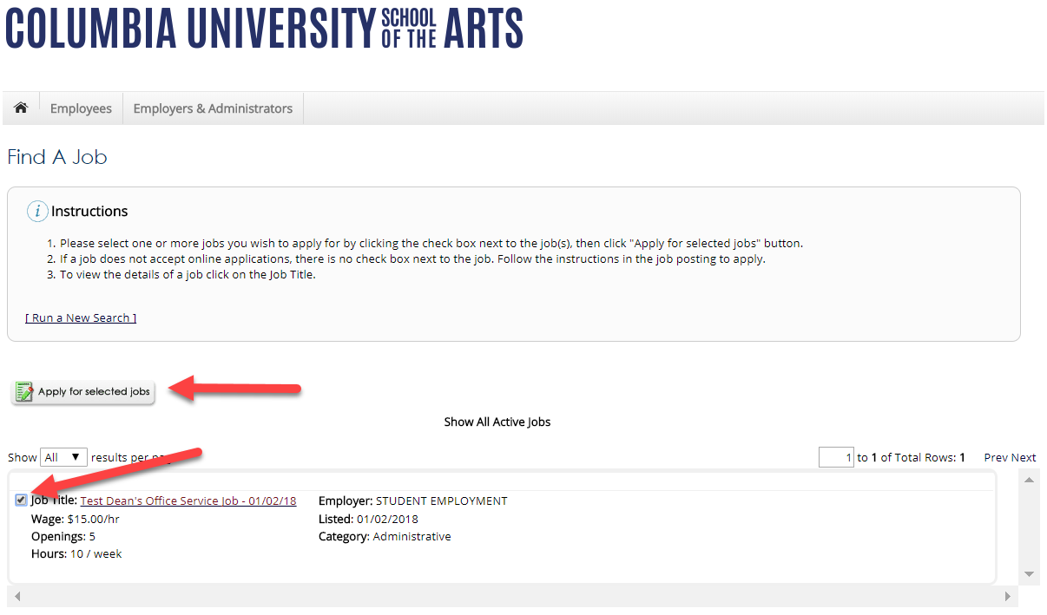
Apply for one or more jobs with one single application!
Simply click the box next to one or more jobs you wish to submit an application
Then, click the ‘Apply for Selected Jobs’ link.

Slide 15
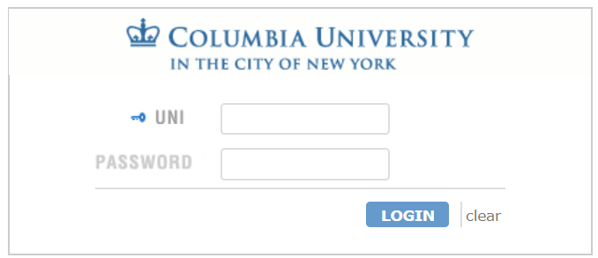
Login to JobX
Login utilizing your Columbia University SOA ‘UNI’ and ‘Password’.

Slide 16
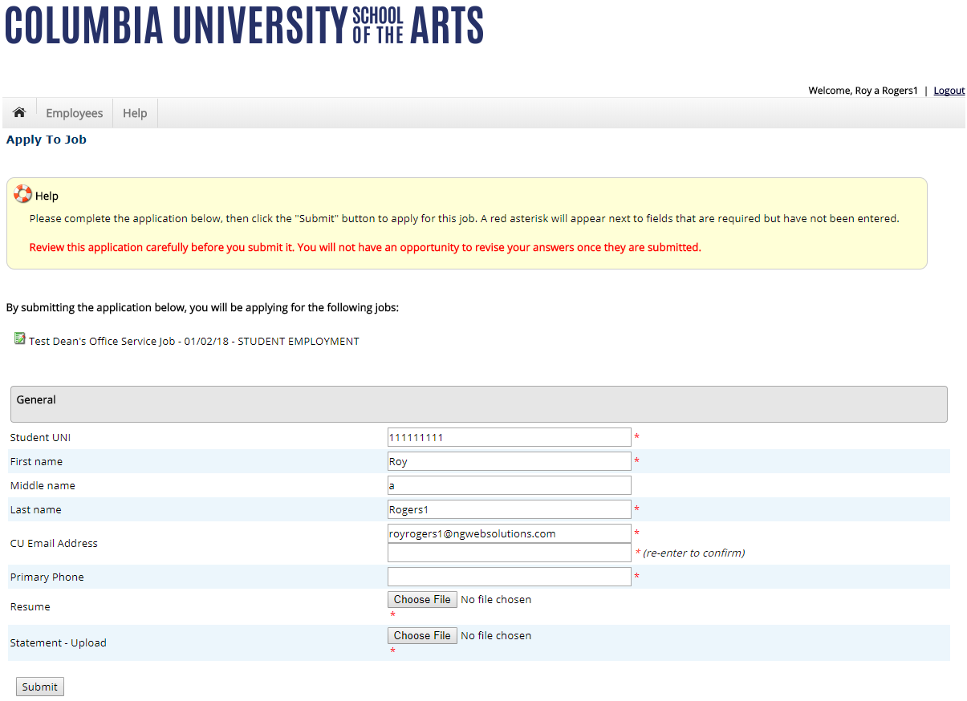
Apply for one or more jobs with one single application!
Please fill out the questions on the application. Any fields with a red asterisk are required to be completed before your application can be successfully completed.
Some of the fields may have information pre-filled. Please be sure to review and update if the information is no longer accurate.
You may upload a resume for the hiring employer to review, if desired. In order to do so, browse to that file on your computer and click ‘Open’,
Lastly, to submit your application to the hiring supervisors for all the jobs you selected, please click the “Submit” button.

Slide 17
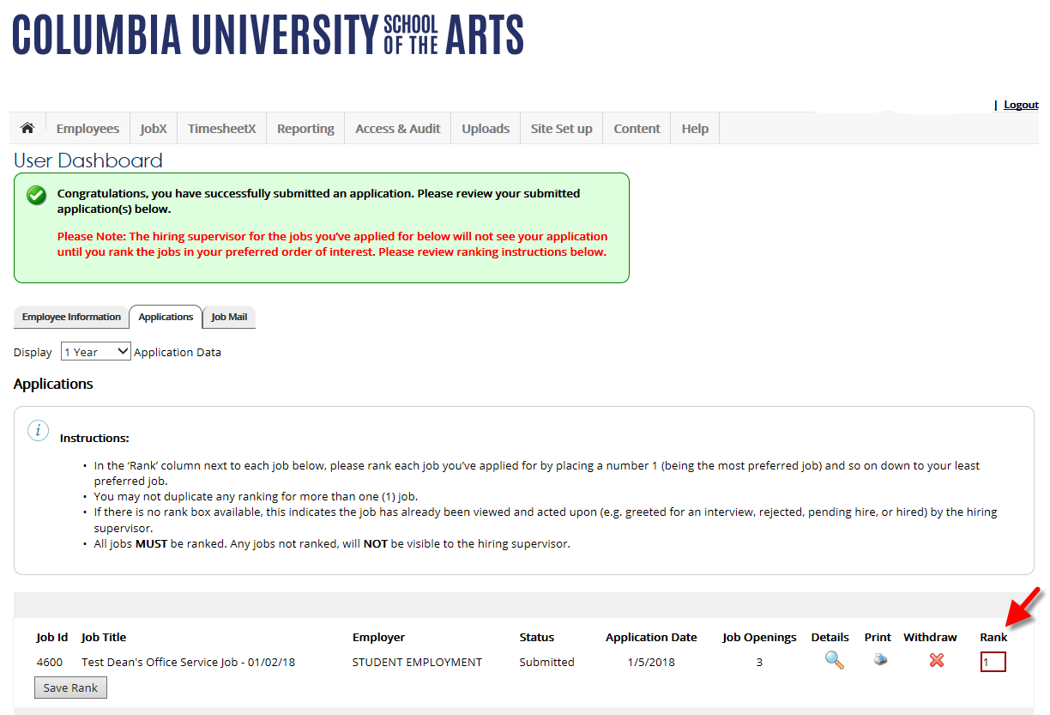
Rank your Applications
Upon successful submission of your application(s), you will be asked to Rank them.
Place a number 1 (being the most preferred job) and so on down to your least preferred job.

Slide 18

How to Complete your JobMail Subscription

Slide 19
What is JobMail?
JobMail is a system that notifies you automatically by email when jobs of interest to YOU are posted.
To enable JobMail, you must complete a JobMail subscription defining what types of jobs interest you. Once you’ve updated your subscription, if any attributes of a new job being listed match your subscription attributes, you will receive email from the system. This email will provide all the necessary details about the job so you can proactively apply for the job, if interested.

Slide 20
Please navigate to the following URL and click the ‘Applicants & Employees’ link.
https://soa.studentemployment.ngwebsolutions.com/

Slide 21
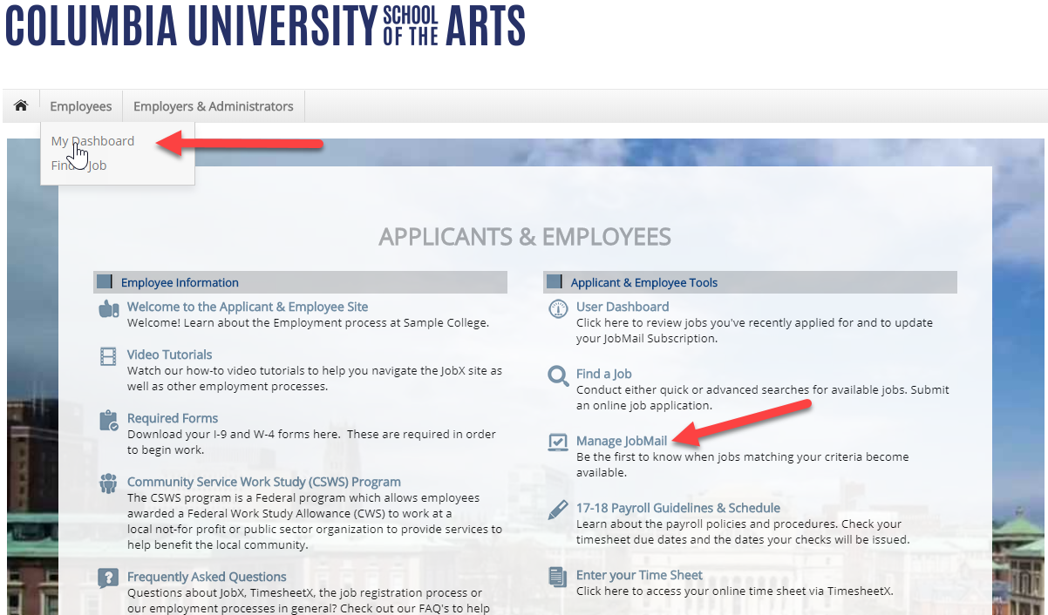
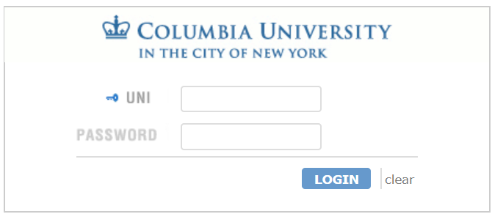
How to Login to JobX JobMail
Step 1: Click ‘Manage JobMail’ on the JobX Applicant & Employees Home Page or click ‘My Dashboard’ from the Employees menu at the top of the screen.
Step 2: Login utilizing your Columbia University SOA UNI and Password.

Slide 22
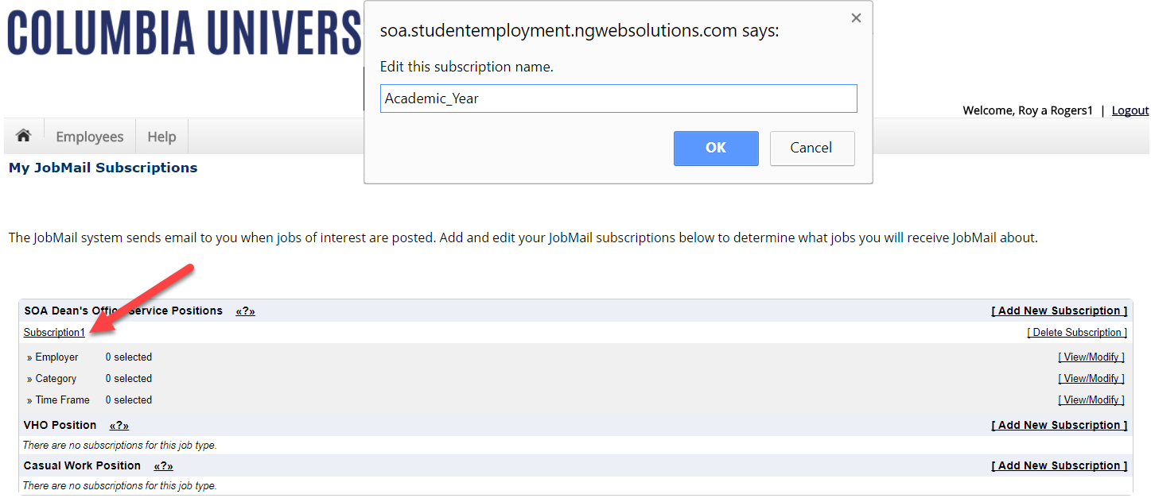
Configure your JobMail Subscription
You may create multiple subscriptions and name them as desired for each Job Type (SOA Dean’s Office Service Positions, VHO Position, Casual Work Position, etc.) supported by JobX.
  For Example: You can create a Summer Subscription that has different attributes than your Academic Year Subscription
For each subscription, you may set criteria
  Desired Departments (a.k.a. JobX Employers) you wish to work (e.g. Dean's Office ($20/hr Positions))
  Desired Job Categories you’re interested in (e.g. Administrative)
  Desired Time Frames you’re interested in working (e.g. Academic Year)

Slide 23
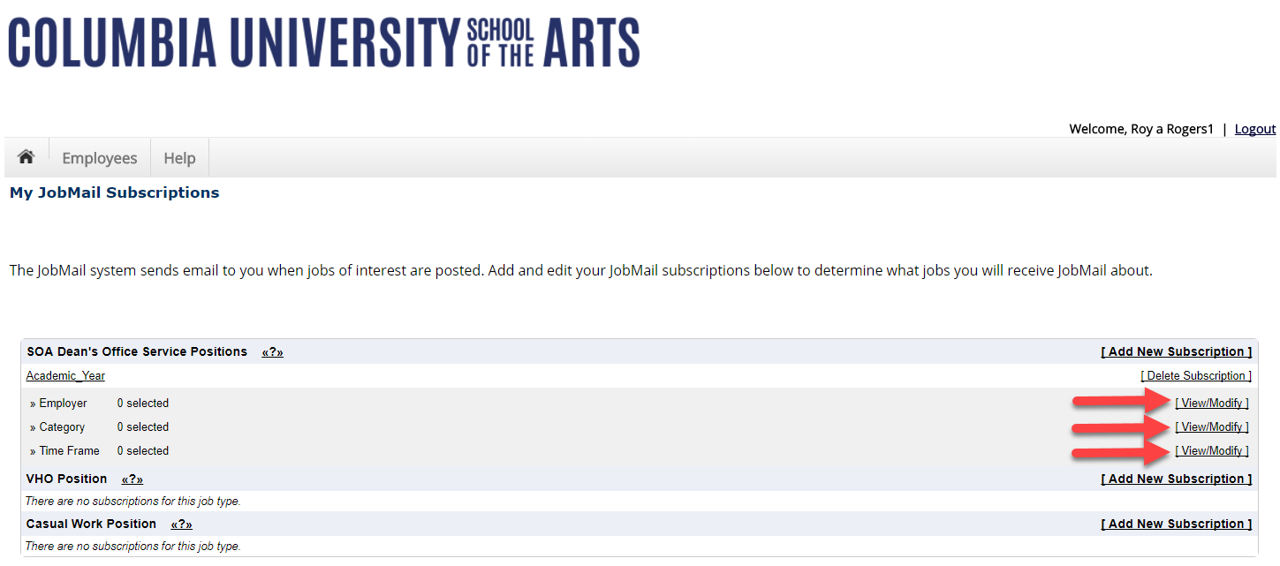
Configure your JobMail Subscription
Click ‘View/Modify’ to add preferences for each Job Type criterion.

Slide 24
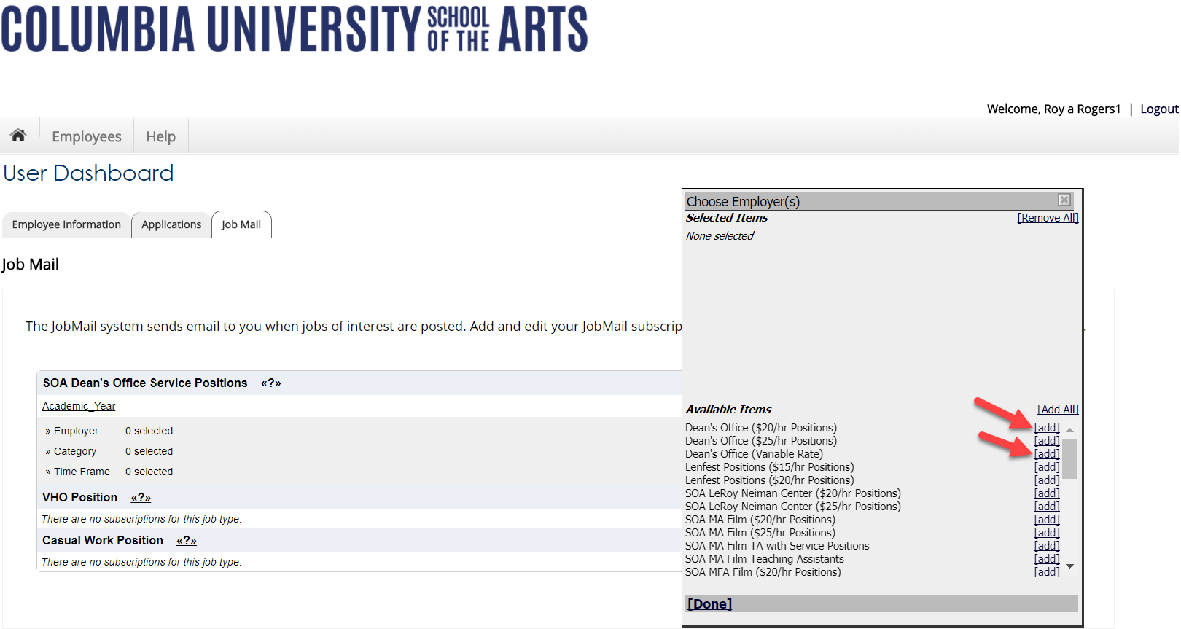
Configure your JobMail Subscription
Click ‘add’ next to each item you wish to add to your JobMail subscription.

Slide 25
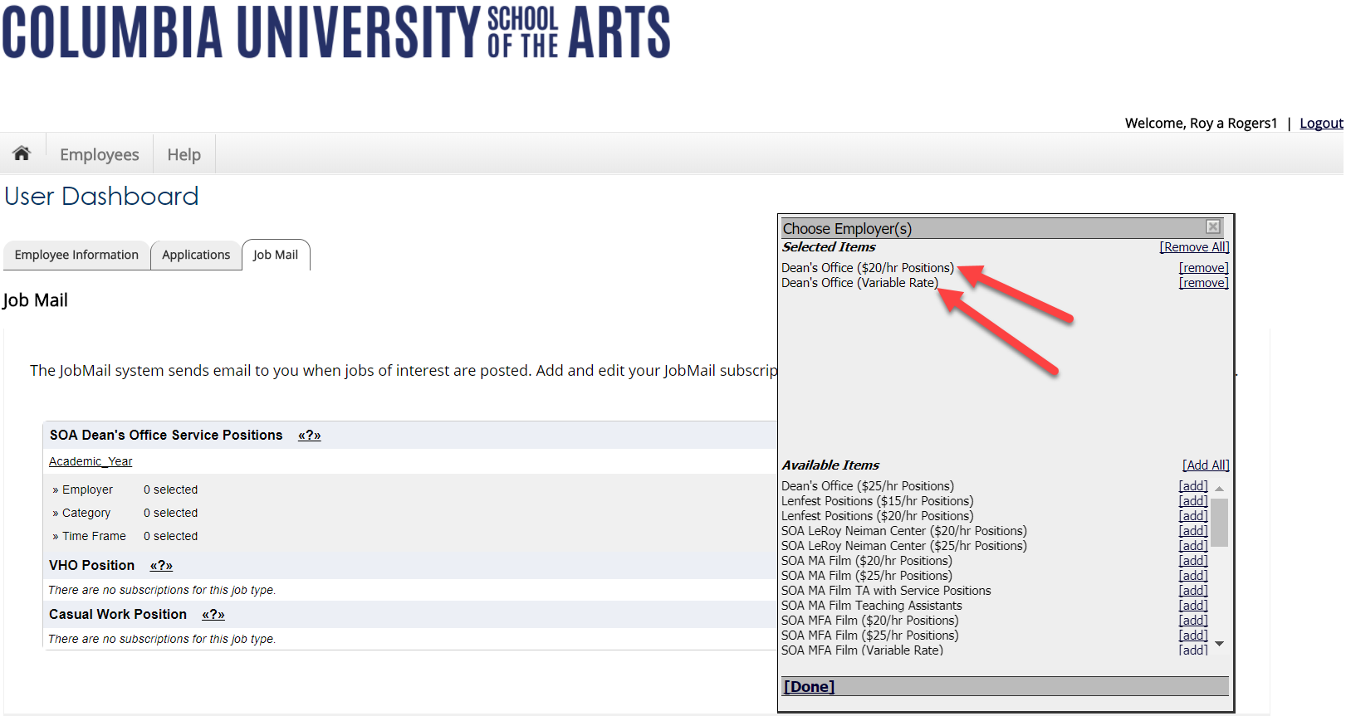
Configure your JobMail Subscription
Your selection(s) will appear in the top under ‘Selected Items’.

Slide 26
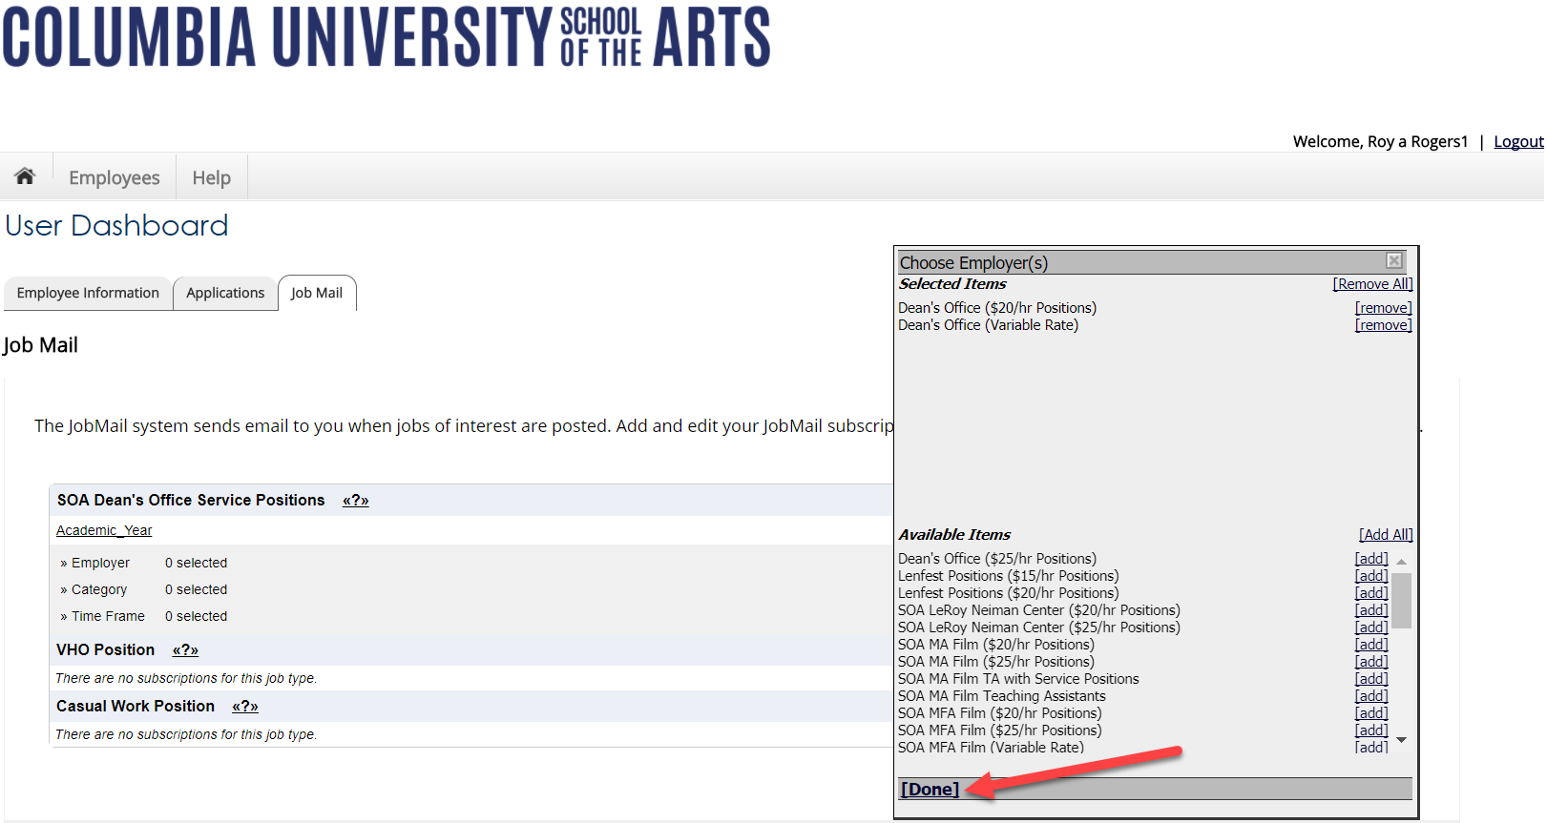
Configure your JobMail Subscription
When you’re finished adding search criteria, click ‘Done.
Repeat this step for each Job Type and Criterion (Department/Employer, Category, and Time Frame).

Slide 27
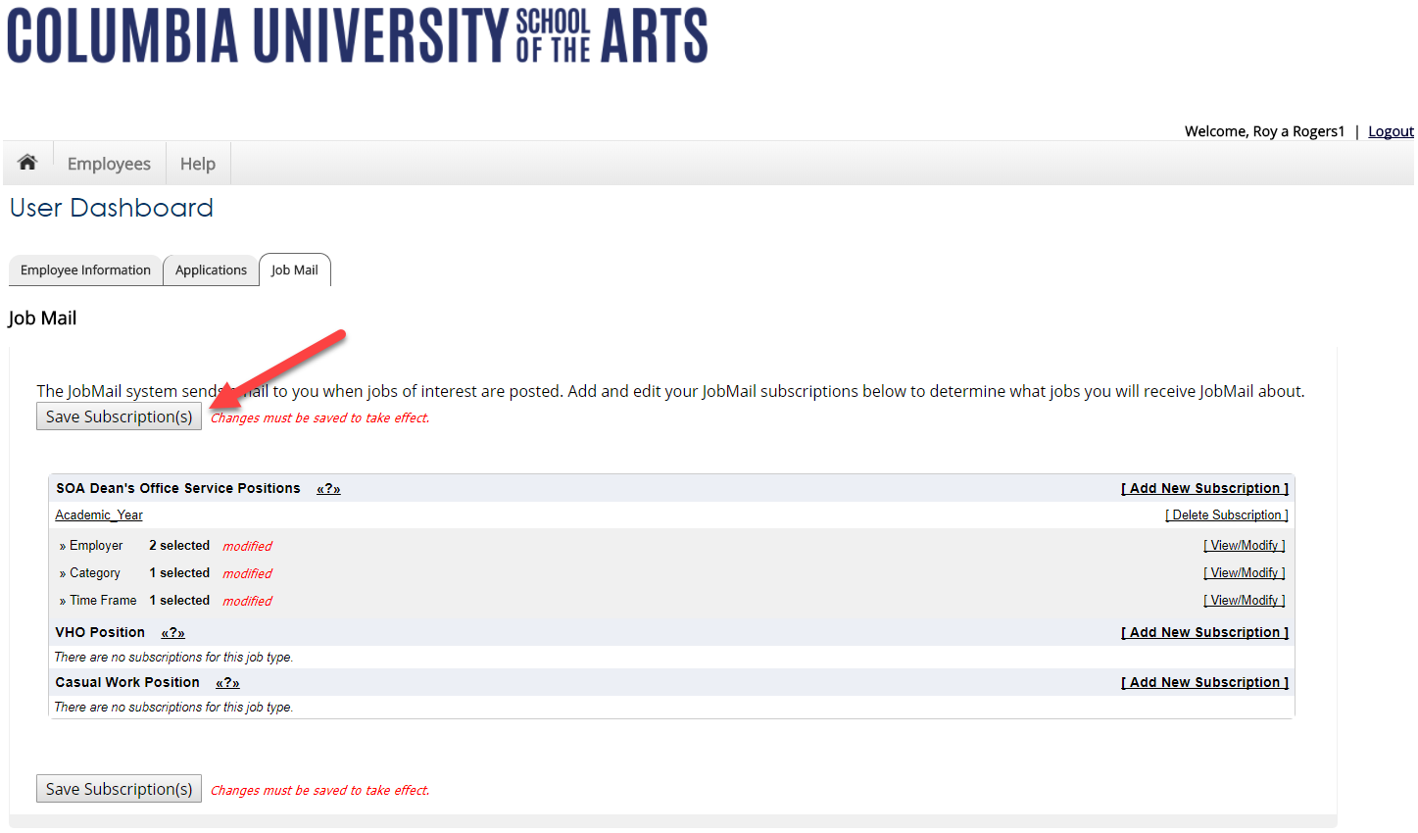
Configure your JobMail Subscription
Click one of the ‘Save Subscription(s)’ buttons to save your subscription.

Slide 28

JobX ‘My Dashboard’ Feature
The JobX ‘My Dashboard’ feature provides a centralized location to access all your JobX data.
‘My Dashboard’ data includes:
  Current / Future / Old / Hires and Awards
  Applications (Status, View, Print, Withdraw)
  JobMail Subscriptions

Slide 29
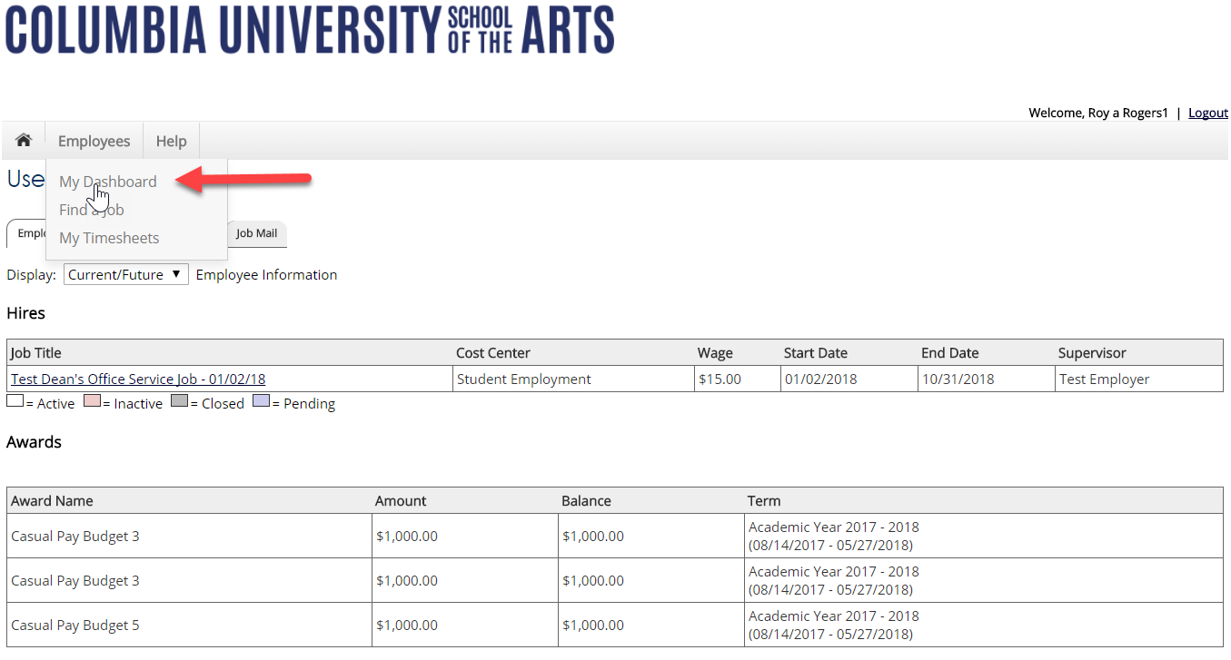
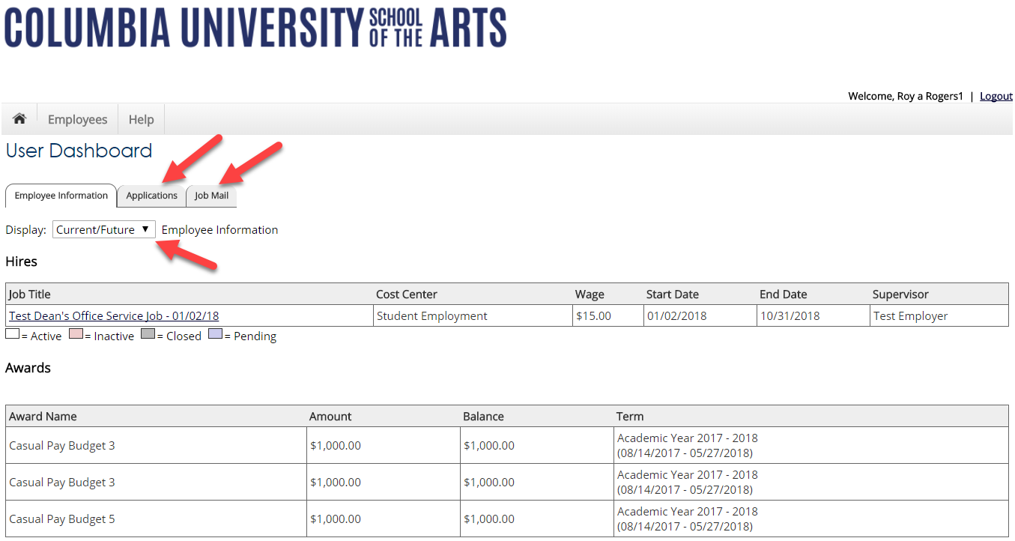
What is the ‘My Dashboard’ Feature?
To access your ‘My Dashboard’ feature, click the ‘My Dashboard’ feature from the Employee menu and login utilizing your Columbia University SOA UNI and Password.
To access the applications, and/or JobMail subscription, simply click the respective tab you wish to view.
To control how much data is presented on the screen, select your preferred option from the ‘Employee Information’ display drop down list.

Slide 30
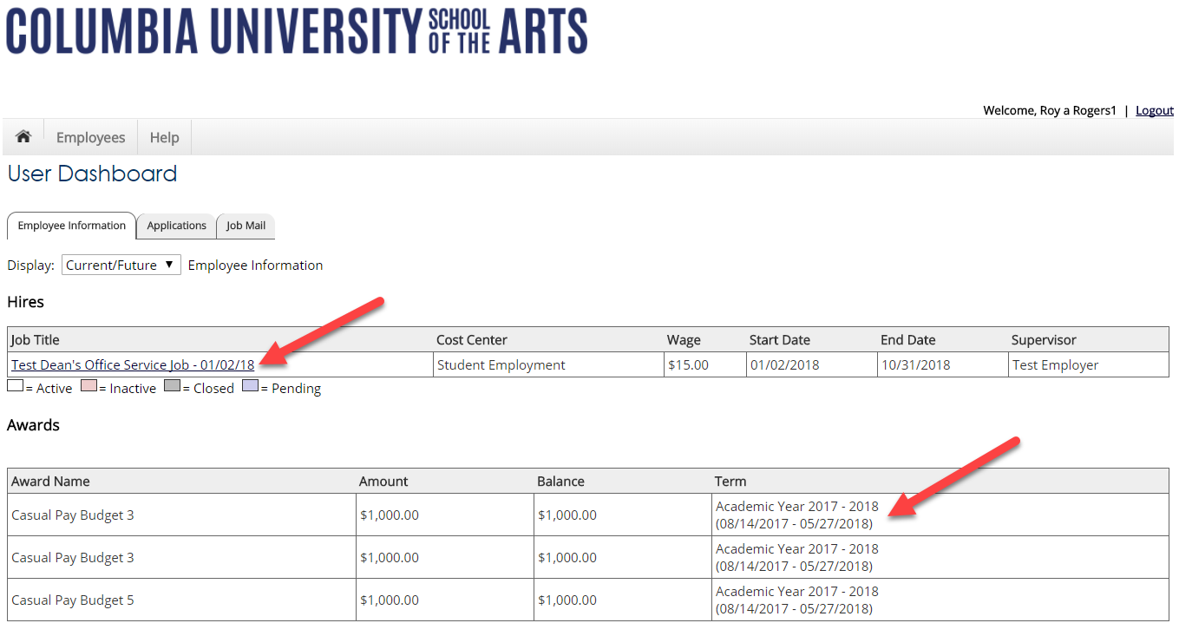
JobX ‘My Dashboard’ Feature
Current/Future/Old hire information can be accessed to ensure accuracy of employment history when creating resumes.
No more waiting in lines to find out your Award Amount or Award Balance – ‘My Dashboard’ ensures this information is at your fingertips.

Slide 31
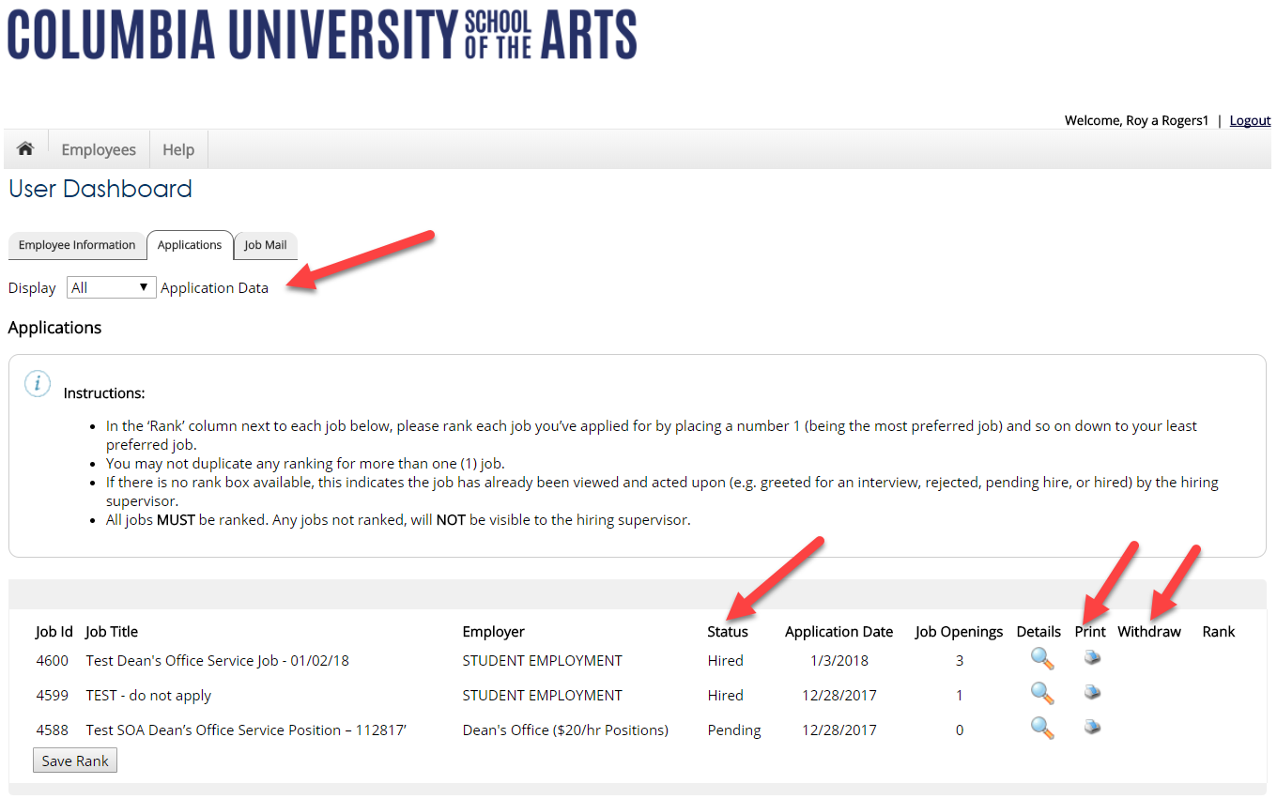
View Applications Previously Submitted
No more waiting in lines to find out the status (submitted, pending hire, hired) of the applications you submitted for your ‘best fit’ jobs. My dashboard provides real-time self-service access to this information.
Applicants can customize their application view and print applications.
Applicants can simply withdraw a previously submitted application by clicking the red ‘X’ next to the applicable application if they no longer have any interest in the job. Please note: The withdraw icon will not be visible for job applications with a status of “Hired” or “Pending”. Applicant’s have two options when withdrawing their application.
  Withdraw an application and email the supervisor to explain why you’re withdrawing your application; OR
  Withdraw an application without emailing the supervisor.

Slide 32
Once you’re hired, what do you do?

Slide 33
How to Login to TimesheetX
Please navigate to the following URL and click the ‘Applicants & Employees’ link.
https://soa.studentemployment.ngwebsolutions.com/

Slide 34
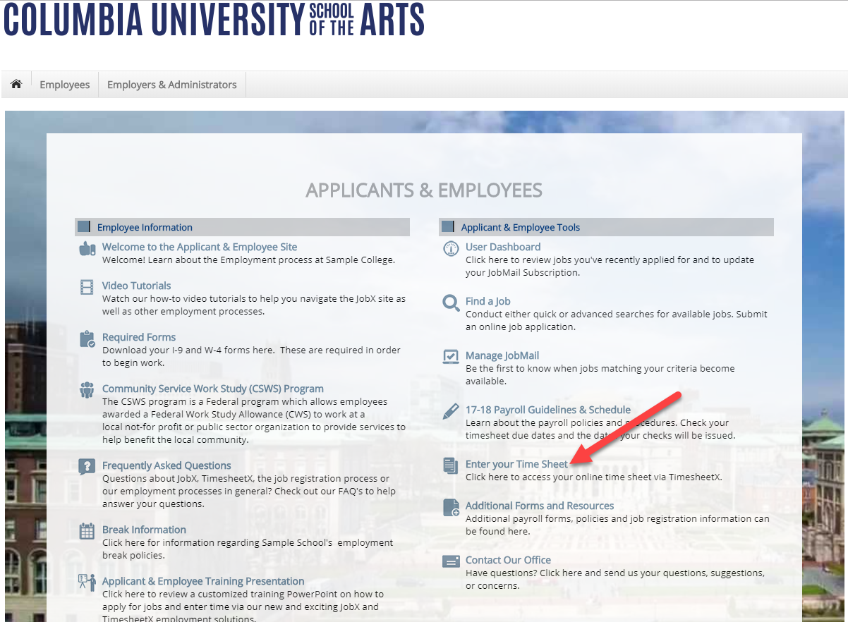
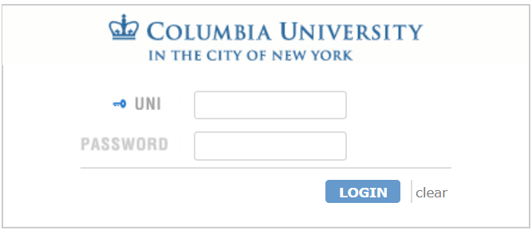
How to Login to TimesheetX
Step 1: Click ’Enter your Time Sheet’ on the JobX/TimesheetX Applicant & Employees Home Page. Or click ‘My Timesheets’ from the Employees menu at the top of the screen.
Step 2: Login utilizing your Columbia University SOA UNI and Password.

Slide 35
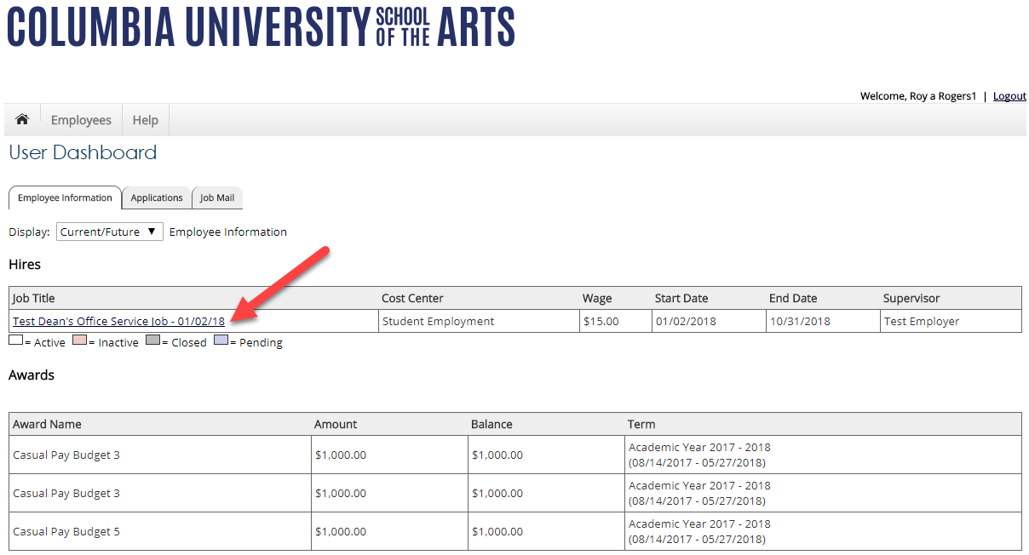
Enter a Time Sheet
First, click the ‘Job Title’ link to access your time sheets.

Slide 36
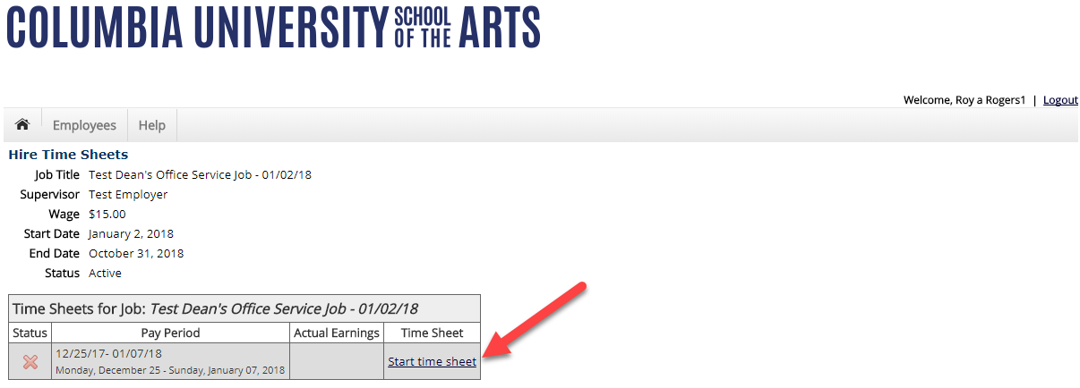
Start a Time Sheet
If this is the first time you are entering a time sheet for the current pay
period, click the ‘Start Time Sheet’ link to the right of the pay period you wish to enter time.

Slide 37
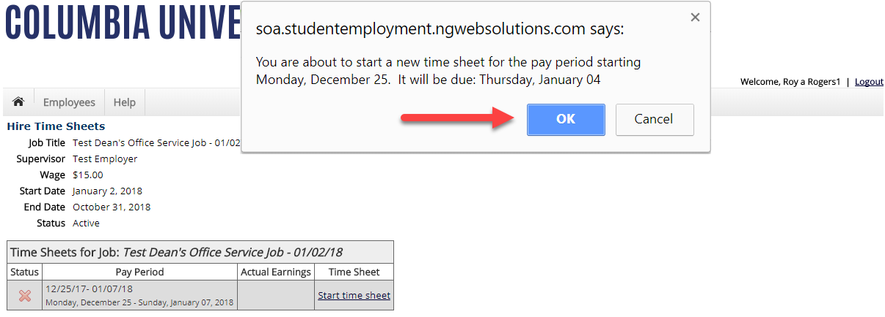
Start a Time Sheet
If you clicked ‘Start Time Sheet’, then click ‘OK’ on the confirmation dialog
box.

Slide 38
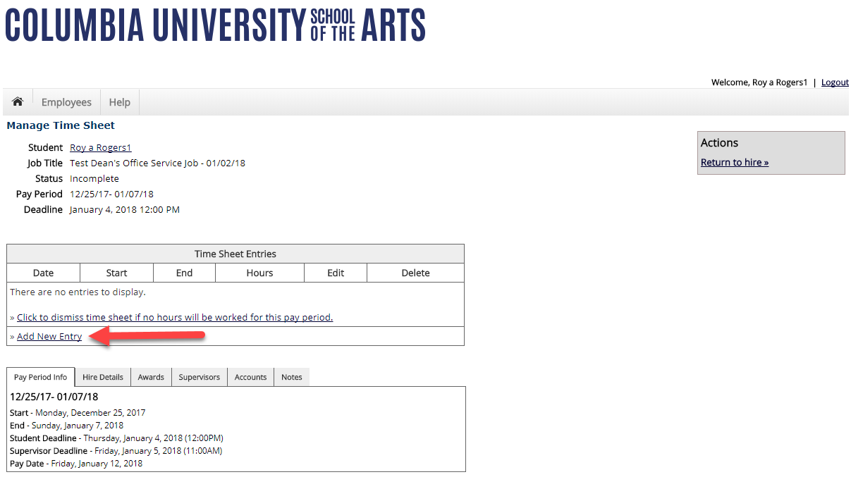
Add a New Time Sheet Entry for Time Worked
Click ‘Add New Entry’ to enter your time.

Slide 39
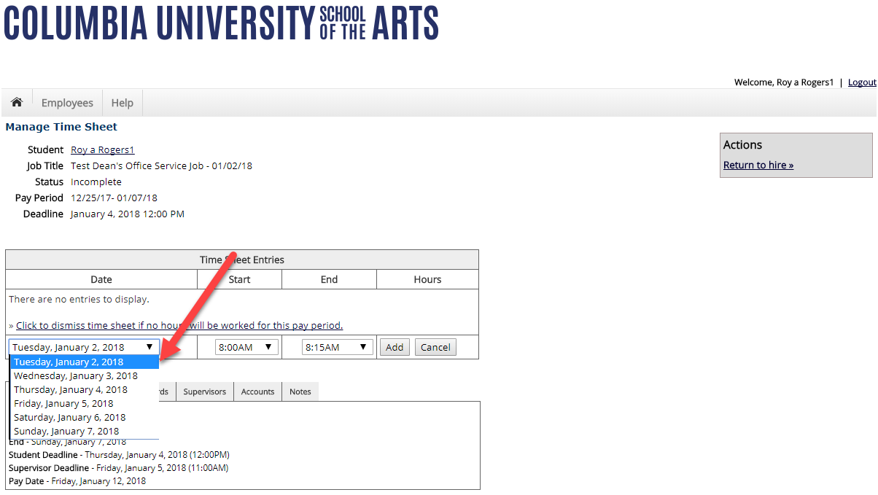
Add a New Time Sheet Entry for Time Worked
Select the ‘Date’ of the time sheet entry from the ‘Date’ column.

Slide 40
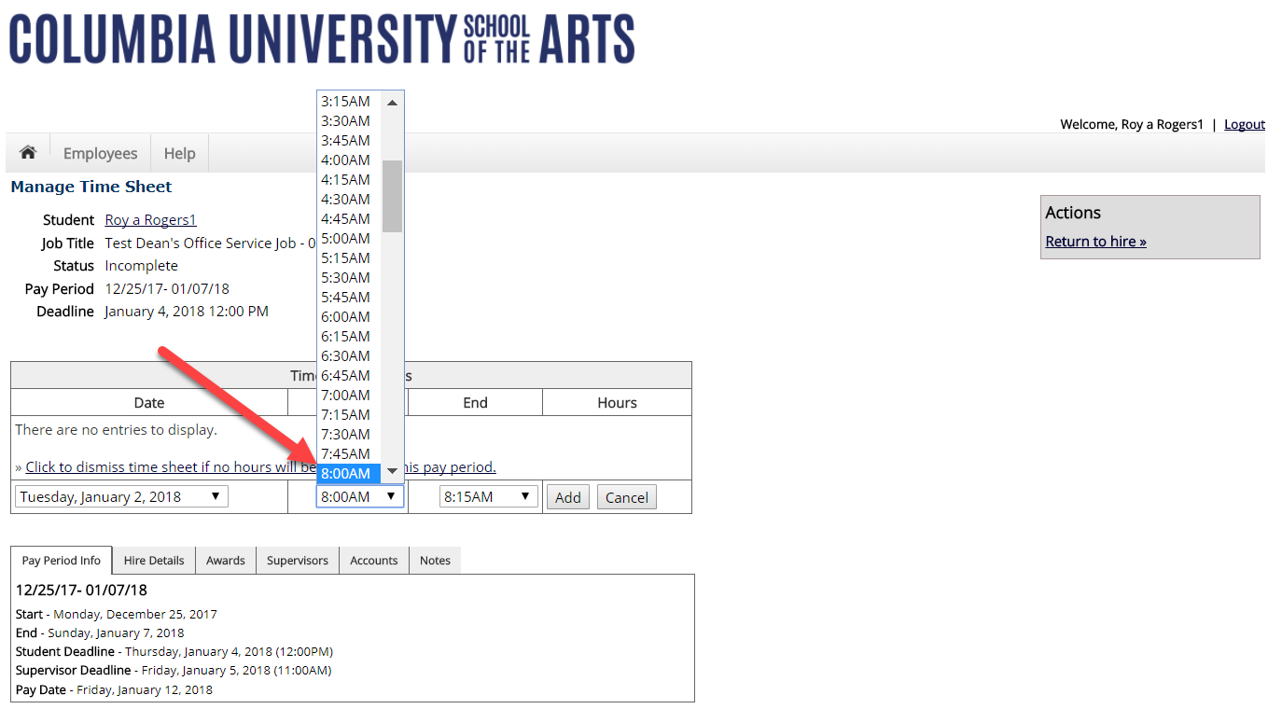
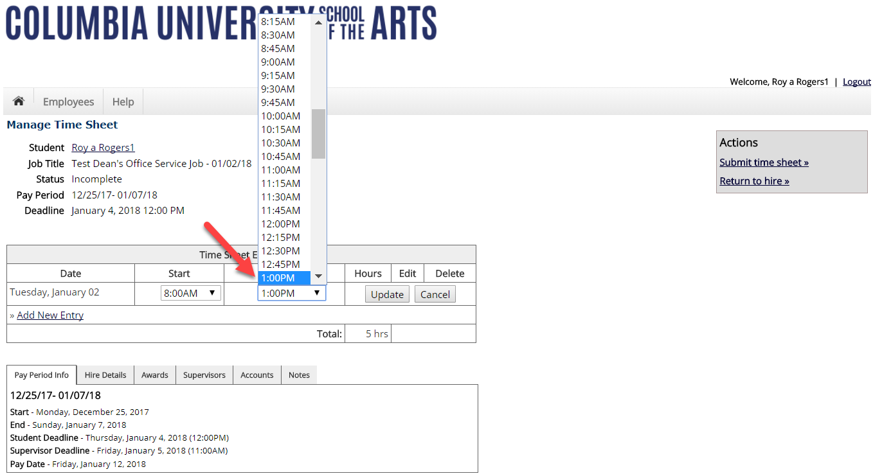
Add a New Time Sheet Entry for Time Worked
Select the Start and End times for the day you are entering time.

Slide 41
Add a New Time Sheet Entry for Time Worked
Click ‘Add’ to save your time sheet entry.

Slide 42
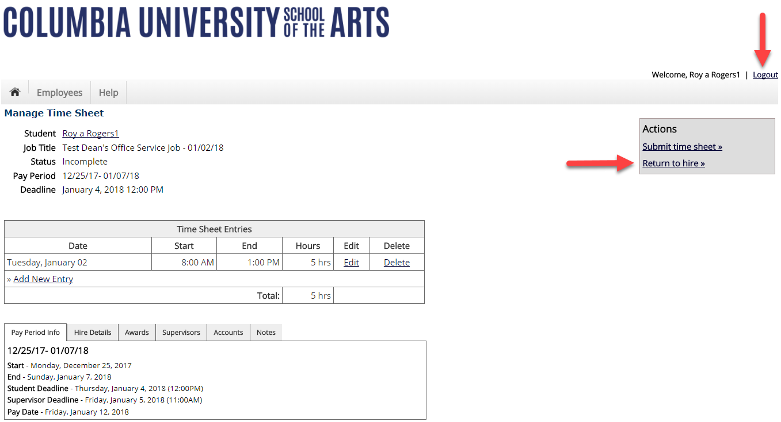
If you’re finished entering time worked, click ‘Return to Hire’ to return
to your list of job(s).
If you wish to log out, click the ‘Log out’ button and you will return to the
Columbia University SOA TimesheetX Home page.

Slide 43
Done Entering Time?
It’s time to hand your time sheet in!

Slide 44
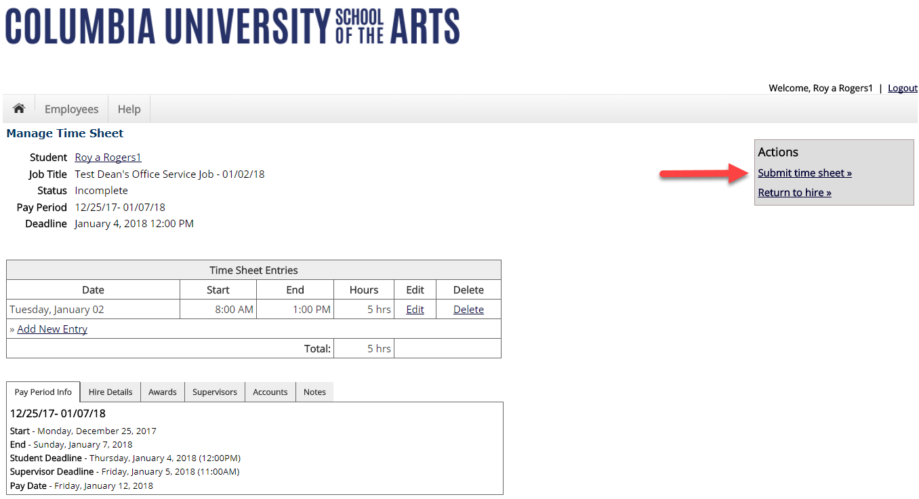
Submit Time Sheet to Supervisor
At the conclusion of the Pay Period, the employee will need to click
the ‘Submit time sheet’ link to systematically pass their electronic time
sheet to their supervisor for review and approval.

Slide 45
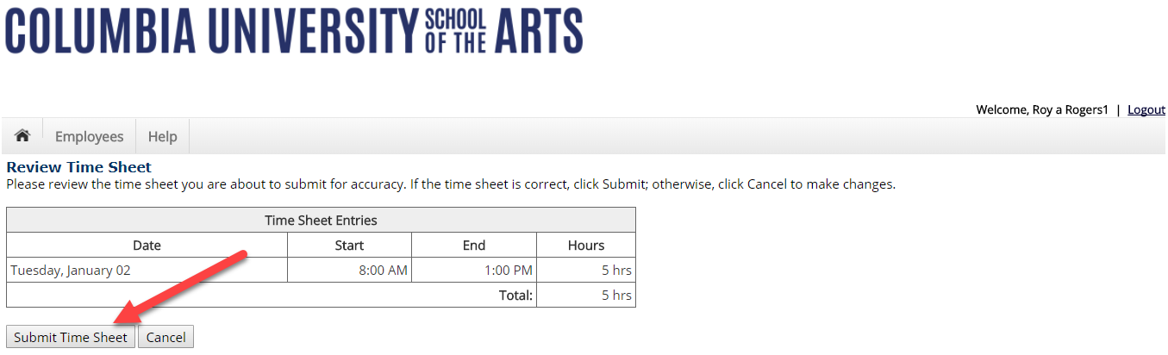
Submit Time Sheet to Supervisor
Click the ‘Submit Time Sheet’ link.

Slide 46
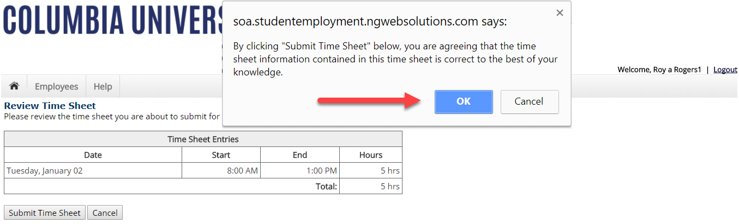
Submit Time Sheet to Supervisor
Click ‘OK’ to confirm. By clicking the ‘Ok’ button, the employee is agreeing the
time sheet information they’ve entered is correct to the best of their knowledge.
This step replaces the wet signature on a paper time sheet with an electronic signature on this paperless time sheet.

Slide 47
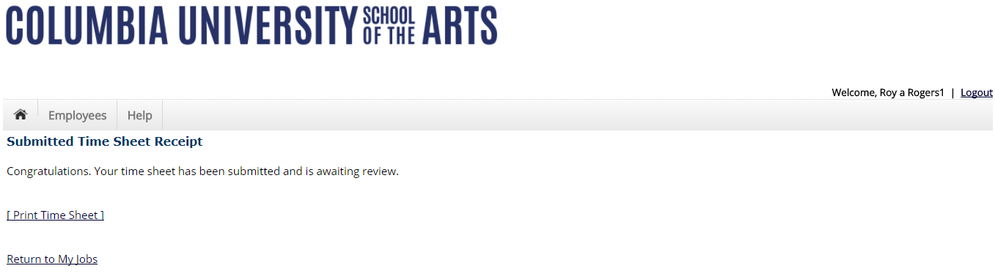
Your time sheet has been placed in your Supervisor’s TimesheetX pending approval queue awaiting his/her review and approval.
You will not be able to access your time sheet again unless your supervisor rejects it back to you during his/her review process.

Slide 48
Congratulations, You’re Finished!
What are the next steps?

Slide 49
Next Steps….
TO BE COMPLETED BY Andrew (if desired)

